Slide 1
Python

Slide 2
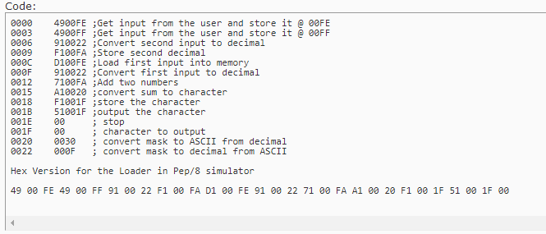
A machine language program to input 2 numbers then adds 2 numbers then output the single-character result.

Slide 3
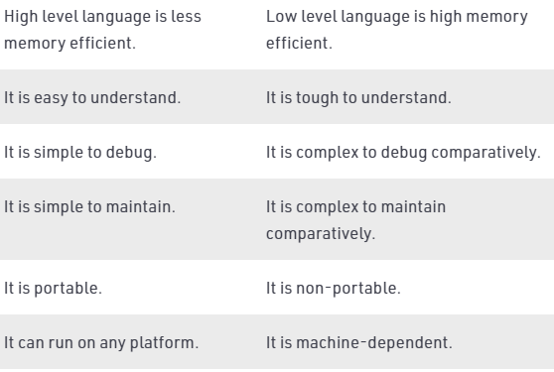
Difference between High Level and Low level languages
The main difference between high level language and low level language is that, Programmers can easily understand or interpret or compile the high level language in comparison of machine.
Ex- c,c++,java,python
On the other hand, Machine can easily understand the low level language in comparison of human beings.

Slide 4
Python is a simple, general purpose, high level, and object-oriented programming language.
Python is easy to learn yet powerful and versatile scripting language, which makes it attractive for Application Development.
Python was invented by Guido van Rossum in 1991 at CWI in Netherland.

Slide 5
Why learn Python?
Python provides many useful features to the programmer. These features make it most popular and widely used language. We have listed below few-essential feature of Python.
Easy to use and Learn
Expressive Language
Interpreted Language
Object-Oriented Language
Open Source Language
Extensible
Learn Standard Library
GUI Programming Support
Dynamic Memory Allocation
Wide Range of Libraries and Frameworks

Slide 6
Where is Python used?
Data Science
Date Mining
Desktop Applications
Console-based Applications
Mobile Applications
Software Development
Artificial Intelligence
Web Applications
Enterprise Applications
3D CAD Applications
Machine Learning
Computer Vision or Image Processing Applications.
Speech Recognitions

Slide 7
There is no use of curly braces or semicolon in Python programming language. It is English-like language. But Python uses the indentation to define a block of code. Indentation is nothing but adding whitespace before the statement when it is needed.
public class HelloWorld {
public static void main(String[] args){
// Prints "Hello, World" to the terminal window.
System.out.println("Hello World");
}
}
On the other hand, we can do this using one statement in Python.
print("Hello World")

Slide 8
Print function
Python print() Function
The print() function displays the given object to the standard output device (screen).
print(*objects, sep=' ', end='\n', file=sys.stdout, flush=False)

Slide 9
Comments in Python
They are used to document code and to help other programmers understand the same. These comments are statements that are not part of your program. For this reason, comment statements are skipped while executing your program.
A hash sign (#) that is not inside a string literal begins a comment. All characters after the # and up to the end of the physical line are part of the comment and the Python interpreter ignores them.
# First comment
print "Hello, Python!" # second comment
Multiple lines comments are slightly different. Simply use 3 single quotes before and after the part you want to be commented.
'''
print("I am in Multiple line comment line 1")
print ("I am in Multiple line comment line 2")
'''

Slide 10
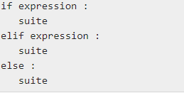
Multiple Statement Groups as Suites
A group of individual statements, which make a single code block are called suites in Python. Compound or complex statements, such as if, while, def, and class require a header line and a suite.
Header lines begin the statement (with the keyword) and terminate with a colon ( : ) and are followed by one or more lines which make up the suite. For example −

Slide 11
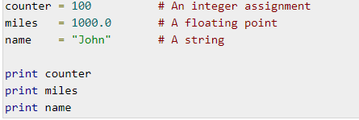
Variables
A variable, as the name indicates is something whose value is changeable over time. In fact a variable is a memory location where a value can be stored. Later we can retrieve the value to use. But for doing it we need to give a nickname to that memory location so that we can refer to it. That’s identifier, the nickname.
Python variables do not need explicit declaration to reserve memory space. The declaration happens automatically when you assign a value to a variable. The equal sign (=) is used to assign values to variables.
The operand to the left of the = operator is the name of the variable and the operand to the right of the = operator is the value stored in the variable
Python id() function returns an identity of an object. This is an integer which is guaranteed to be unique. This function takes an argument an object and returns a unique integer number which represents identity.

Slide 12
Python Identifiers
Python Identifier is the name we give to identify a variable, function, class, module or other object. That means whenever we want to give an entity a name, that’s called identifier.
Identifiers can be combination of uppercase and lowercase letters, digits or an underscore(_). So myVariable, variable_1, variable_for_print all are valid python identifiers.
An Identifier can not start with digit. So while variable1 is valid, 1variable is not valid.
We can’t use special symbols like !,#,@,%,$ etc in our Identifier.
Identifier can be of any length.

Slide 13
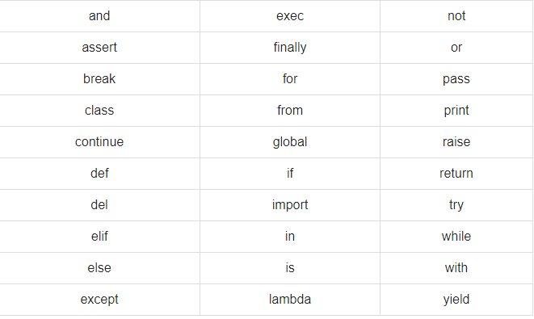
Reserved Words
The following list shows the Python keywords. Python keywords are the words that are reserved. That means you can’t use them as name of any entities like variables, classes and functions. All the Python keywords contain lowercase letters only.
They are for defining the syntax and structures of Python language.

Slide 14

Quotation in Python
Python accepts single ('), double (") and triple (''' or """) quotes to denote string literals, as long as the same type of quote starts and ends the string.
The triple quotes are used to span the string across multiple lines. For example, all the following are legal −

Slide 15
Standard Data Types
The data stored in memory can be of many types. For example, a person's age is stored as a numeric value and his or her address is stored as alphanumeric characters. Python has various standard data types that are used to define the operations possible on them and the storage method for each of them.
There are different types of data types in Python. Some built-in Python data types are:
Numeric data types: int, float, complex
String data types: str
Sequence types: list, tuple, range
Binary types: bytes, bytearray, memoryview
Mapping data type: dict
Boolean type: bool
Set data types: set, frozenset

Slide 16
Number data types
Number data types store numeric values. Number objects are created when you assign a value to them. For example −
X=10
Y=201
Python supports four different numerical types −
int – holds signed integers of non-limited length.
long- holds long integers(exists in Python 2.x, deprecated in Python 3.x).
float- holds floating precision numbers and it’s accurate up to 15 decimal places.
complex- holds complex numbers.
if we want to see what type of numerical value is it holding right now, we can use type().

Slide 17
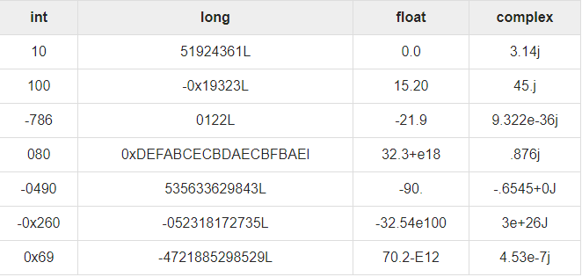
Examples of number data types

Slide 18
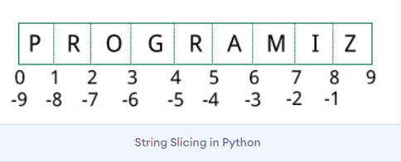
Strings
Strings in Python are identified as a contiguous set of characters represented in the quotation marks. Python treats single quotes same as double quotes. Triple quotes are used to define multi-lines strings.
Subsets of strings can be taken using the slice operator ([ ] and [:] ) with indexes starting at 0 in the beginning of the string and working their way from -1 at the end.
The plus (+) sign is the string concatenation operator and the asterisk (*) is the repetition operator. For example −

Slide 19
Built-in methods
dir(__builtins__) returns list of all existing built-in methods in python.
Examples: print, input, len, sum,sorted, ord, chr, min, max, open,read,write
print(ord(‘a’)). ## returns ascii value of a character
Print(chr(ord(‘a’)) ## returns character from ascii value

Slide 20
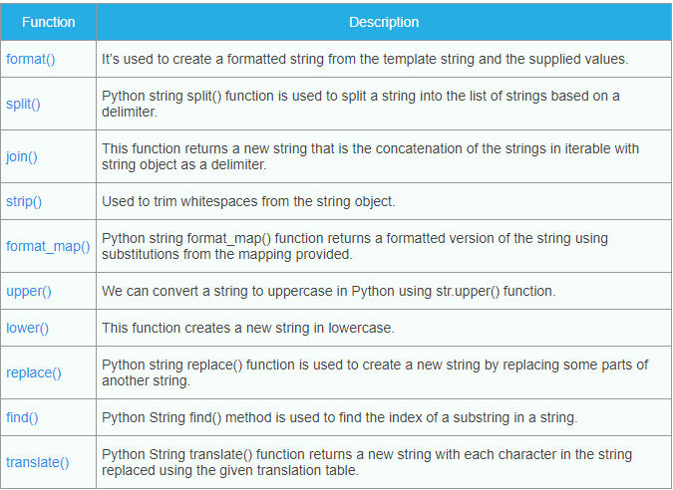
Must Know String Functions

Slide 21
List
List is a versatile datatype available in Python. Basically a python list is comma-separated values which are called items.
List in python is written within square brackets. Interestingly it’s not necessary for items in a list to be of same types.
To some extent, lists are similar to arrays in C. One difference between them is that all the items belonging to a list can be of different data type.
The values stored in a list can be accessed using the slice operator ([ ] and [:]) with indexes starting at 0 in the beginning of the list and working their way to end -1. The plus (+) sign is the list concatenation operator, and the asterisk (*) is the repetition operator.
list = [ 'abcd', 786 , 2.23, 'john', 70.2 ]
tinylist = [123, 'john']

Slide 22
List initialization
#an empty list empty_list=[]
#a list of strings str_list=['this', 'is', 'a', 'list']
# a list of integers int_list=[1,2,3,4,5]
#a list of mixed type of items mixed_list=['this', 1, 'is', 2, 'a', 3, 'mixed',4, 'list',5]

Slide 23
Python Tuples
A tuple is another sequence data type that is similar to the list. A tuple consists of a number of values separated by commas. Unlike lists, however, tuples are enclosed within parentheses.
The main differences between lists and tuples are: Lists are enclosed in brackets ( [ ] ) and their elements and size can be changed, while tuples are enclosed in parentheses ( ( ) ) and cannot be updated. Tuples can be thought of as read-only lists.
Tuples are immutable objects, the defined elements cannot be changed or updated. But you can combine two tuples into a third one when required.
Deleting individual elements is not possible, but with the del keyword, you can remove the tuple from your program.

Slide 24
Syntax and Examples
SampleTuple = ("Element1", "Element2", "Element3")
Here are some more examples of tuple definitions:
#an empty tuple
emptyTup=()
#tuple of integers
intTup=(1,2,3,4,5)
#Tuples with multiple datatypes
multiTuple = ("This is a string", 1, True)

Slide 25
Python Dictionary
A python dictionary is basically a sequence of key-value pair. This means, for each key, there should be a value. All the keys are unique.
Dictionaries are enclosed by curly braces ({ }) and values can be assigned and accessed using square braces ([]).
A python dictionary is basically a sequence of key-value pair. This means, for each key, there should be a value. All the keys are unique.
my_dictionary = {} #init empty dictionary
#init dictionary with some key-value pair
another = {
#key : value,
'man' : 'Bob',
'woman' : 'Alice',
'other' : 'Trudy'
}

Slide 26
Type Conversion
The process of converting the value of one data type (integer, string, float, etc.) to another data type is called type conversion. Python has two types of type conversion.
Implicit Type Conversion
Explicit Type Conversion
Implicit Type Conversion
In Implicit type conversion, Python automatically converts one data type to another data type. This process doesn't need any user involvement.
num_int = 123
num_flo = 1.23
num_new = num_int + num_flo
Python promotes the conversion of the lower data type (integer) to the higher data type (float) to avoid data loss.

Slide 27
Explicit Type Conversion
Addition of string(higher) data type and integer(lower) datatype
num_int = 123
num_str = "456"
In Explicit Type Conversion, users convert the data type of an object to required data type. We use the predefined functions like int(), float(), str(), etc to perform explicit type conversion.
This type of conversion is also called typecasting because the user casts (changes) the data type of the objects.
Syntax :
<required_datatype>(expression)

